Slide 1
Midterm Project: Class Imbalance Problem
By: Michael Schmidt
A20460468
ECE 508-01

Slide 2
Table of Contents:
Introduction
Baseline Model Description
Improvements Made + Evaluations
Resampling
Decoupling
Advanced Loss Functions
Data Augmentations
Conclusion

Slide 3
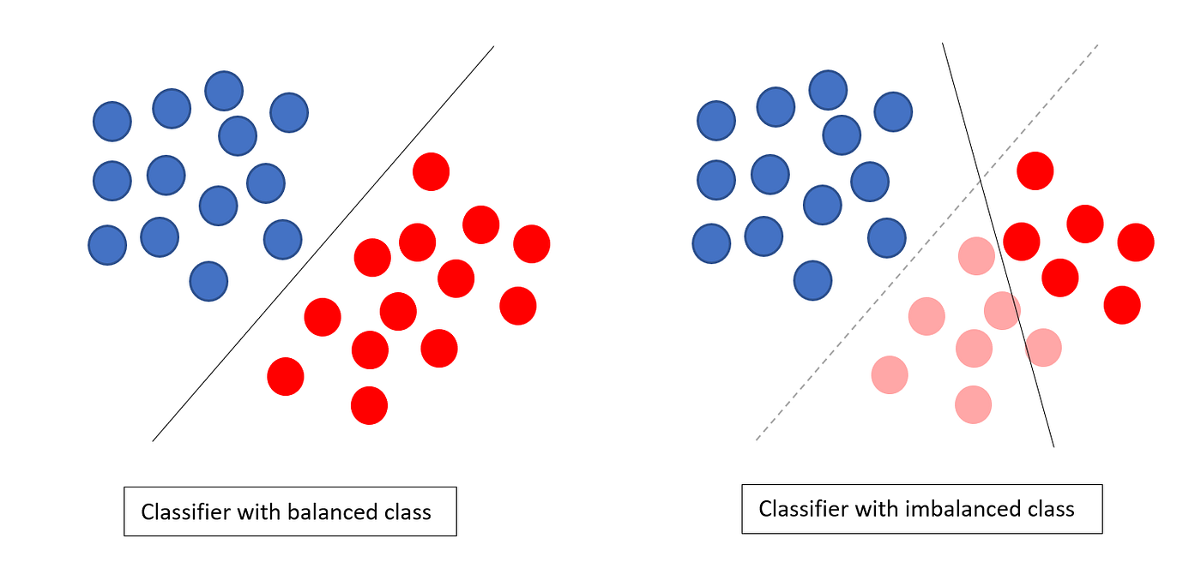
Introduction: The Class Imbalance Problem
Real World Data not always balanced
Models tend to be bias with classes with more samples
While head classes thrive, Tail classes suffer
Misleading Evaluation Metrics (Accuracy != F1-score)
A machine sorting green apples based on color doesn’t know what to do with a green pear!

Slide 4
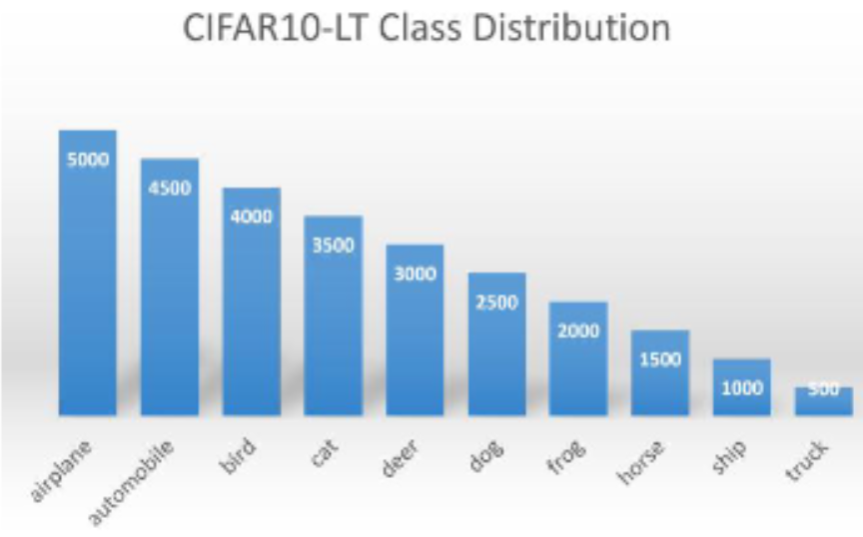



Introduction: The Dataset
Custom CIFAR-10 LT dataset
27,500 total samples of different classes (32x32 image size)
10,000 for testing (1,000 per class)
Original CIFAR-10: 50,000 samples; 10,000 test

Slide 5
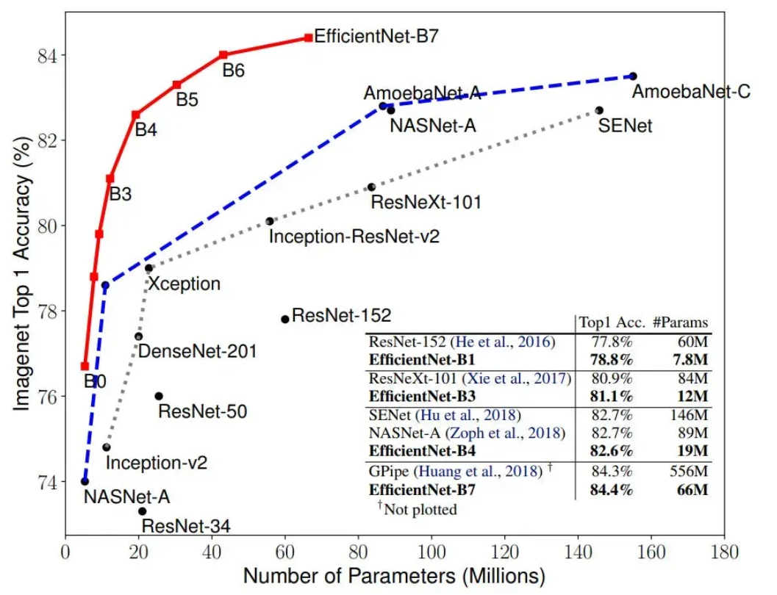
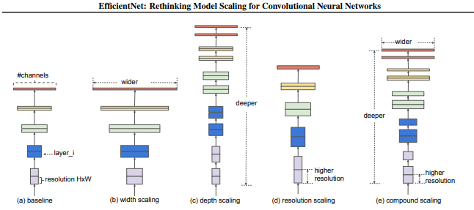
Baseline Model Description: EfficientNet-B0
Introduced in “EfficientNet: Rethinking Model Scaling for Convolutional Neural Networks” (Tan & Le, 2019)
Uses "Compound Scaling" to balance: Depth, Width, resolution
Achieves "State-of-the-Art" accuracy with 8x fewer params than ResNet

Slide 6
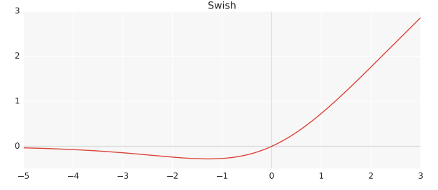
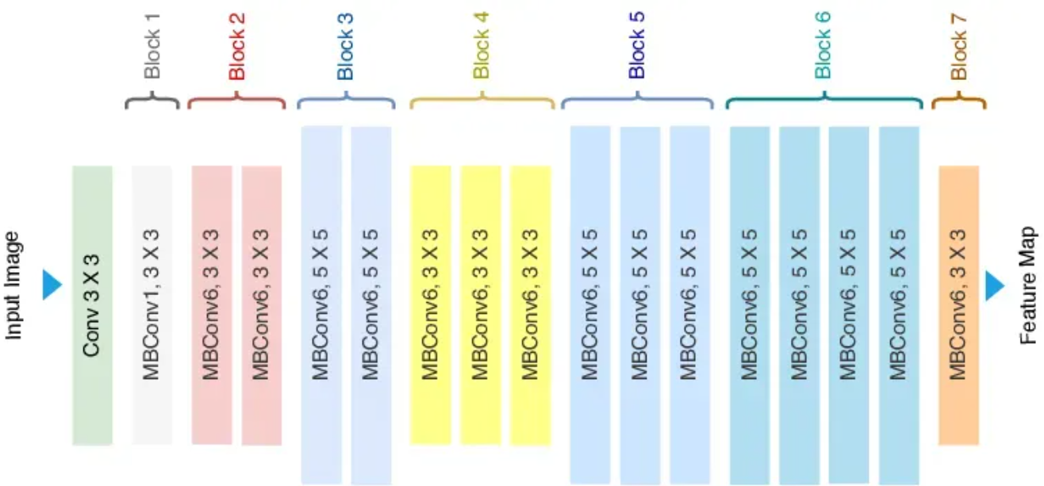
Baseline Model Description: EfficientNet-B0
MBConv:
Derived MobileNetv2
1×1 expansion → depthwise 3×3/5×5 conv → 1×1 projection
Uses residual connections and depthwise separable convolutions for efficiency
Each block includes:
Squeeze-and-Excitation (SE) attention
Swish Activation

Slide 7
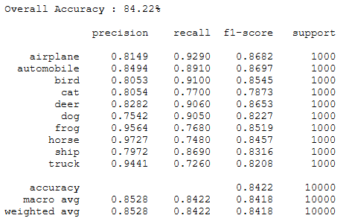
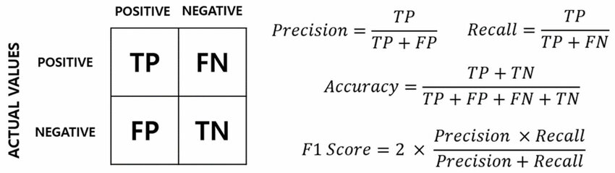
Baseline Model Description: EfficientNet-B0
Hyperparams Limits:
LR: 1e-4
Decay: 0.9999
Epoch: 30
Batch size: 128
Base accuracy: 84.22%
Of all positive prediction, how many is true positive?
Of all true positives, how many was predicted right?
How often is the model correct overall?
Balance of Precision & Recall

Slide 8
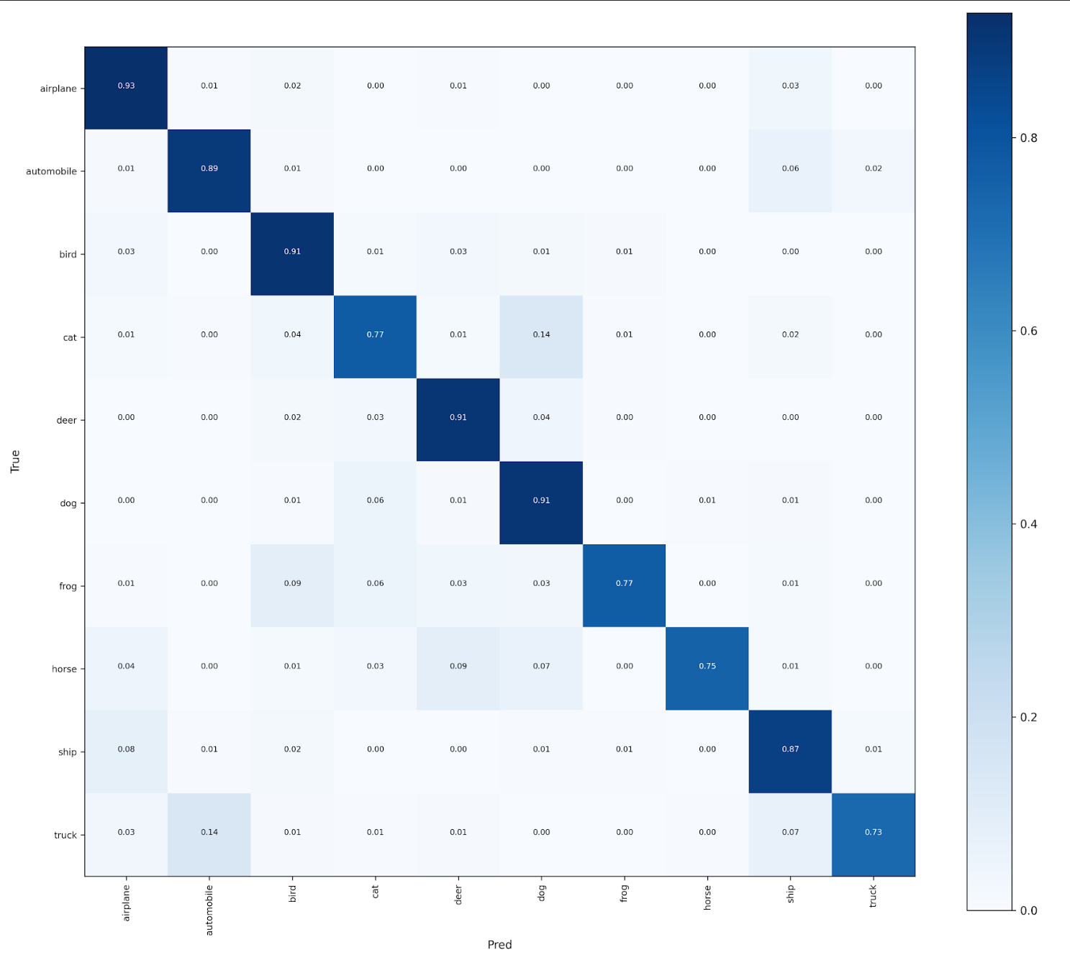
Baseline Model Description: EfficientNet-B0
Lots of misclassification of tail classes needs to be fixed

Slide 9
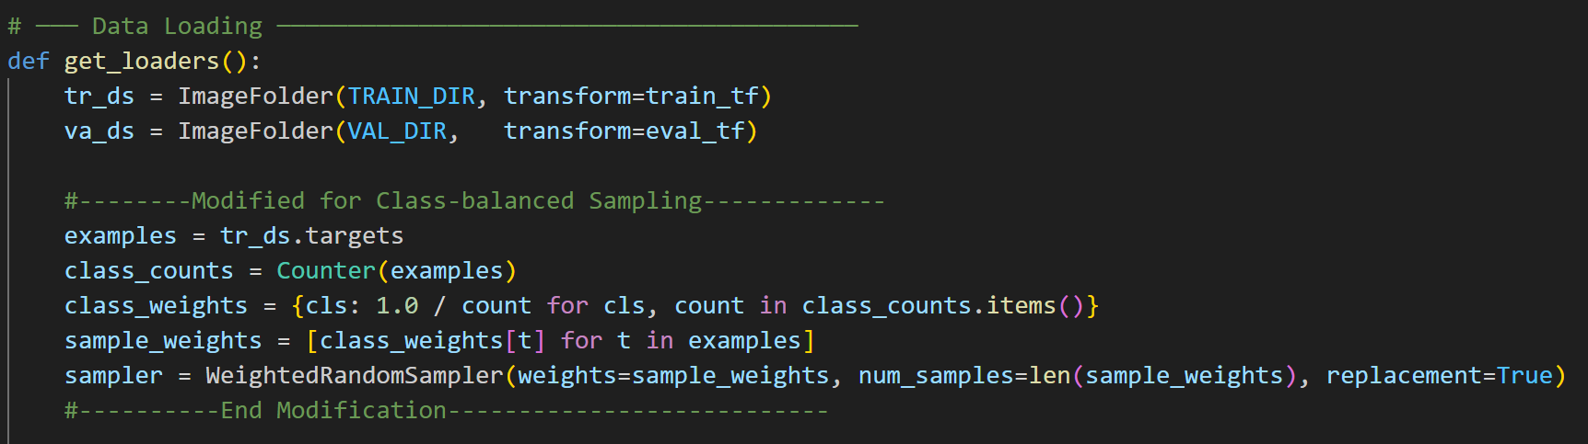
Improvements Made: Resampling
What's currently happening:
DataLoader "Shuffles" all samples uniformly in dataset
Each sample regardless of class has same P(x) of being chosen
Head classes gets chosen more than tail classes
Fix: Class-Balanced Sampling
Sample Uniformly over classes
How it works:
Counts samples per class and calc weights to each class:
Assigns weights to each individual image
Sampler selects samples based on their proportional weights
Article: Y. Cui, M. Jia, T.-Y. Lin, Y. Song and S. Belongie, “Class-balanced loss based on effective number of samples,” arXiv preprint arXiv:1901.05555, Jan. 2019.

Slide 10
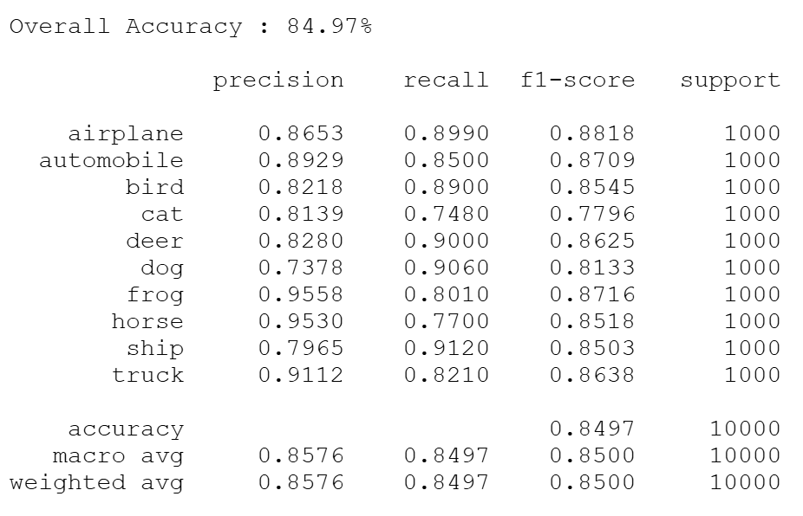
Improvements Made: Resampling
No Modification:
Class-Balanced Sampling:
Summary: Accuracy improved by 0.75%. Recall of tail classes improved, while head classes decreased. Macro-avg increased

Slide 11
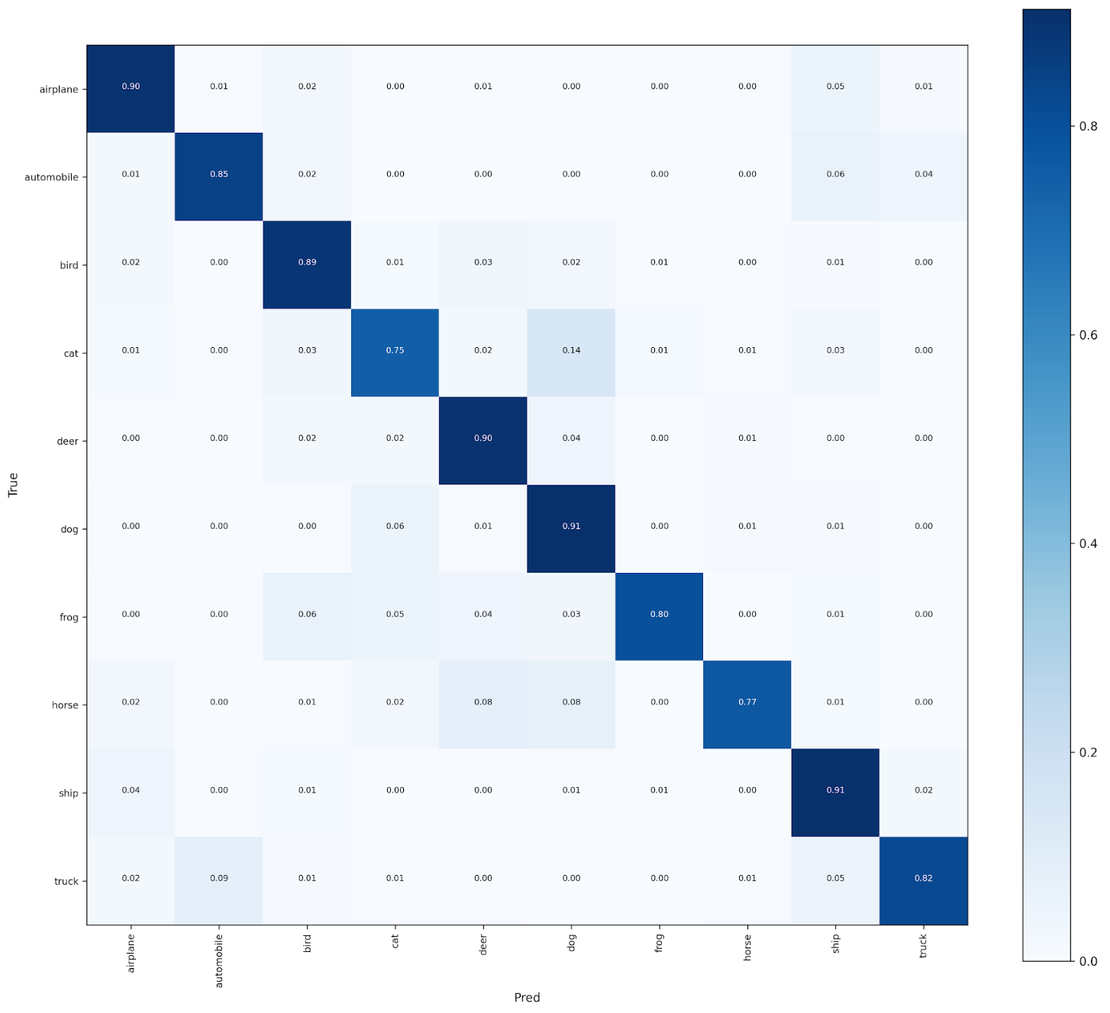
Improvements Made: Resampling
No Modification:
Class-Balanced Sampling:
Summary: Slightly less mispredictions in lower half of matrix

Slide 12
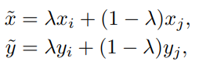
Improvements Made: Data Augmentations
What's currently happening:
Each sample corresponds to a single class
Model learns by minimizing cross-entropy between hard labels and predictions
Decision boundaries forced to be sharp
Model memorizes rather than generalizes samples
Fix: MixUp
Replaces real batch with linear combination of two random samples
Blends both image contents and labels
Forces model to learn smooth transitions between classes
How it works:
Creates linear combination of samples in training loop
Loss function becomes:
Article: H. Zhang, M. Cissé, Y. N. Dauphin, and D. Lopez-Paz, “mixup: Beyond empirical risk minimization,” arXiv preprint arXiv:1710.09412, 2018.

Slide 13
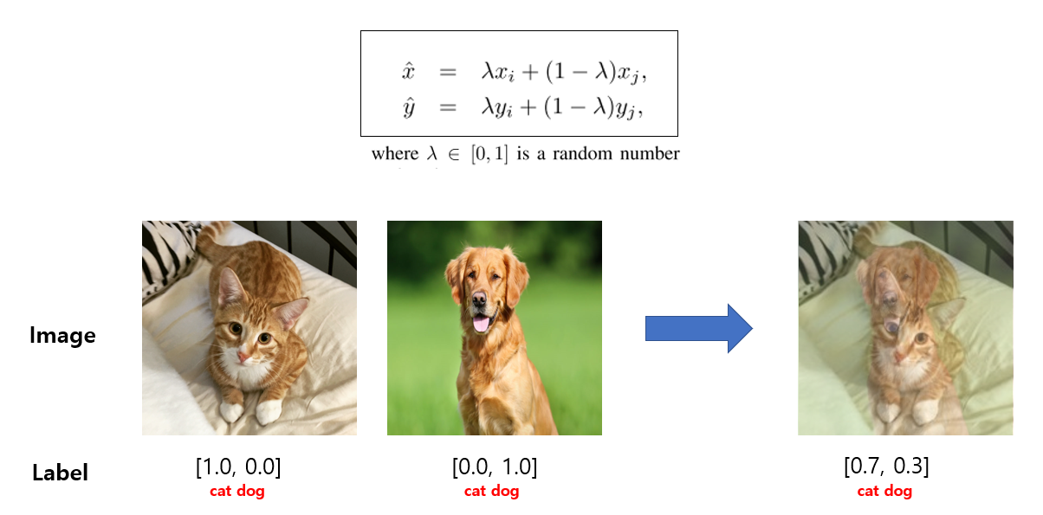
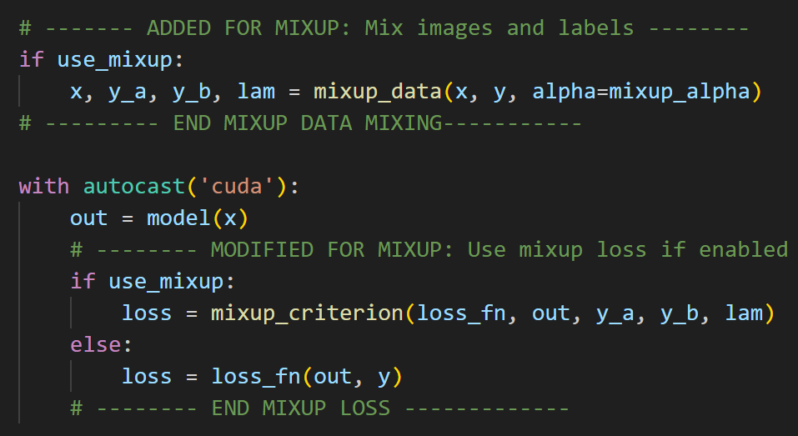
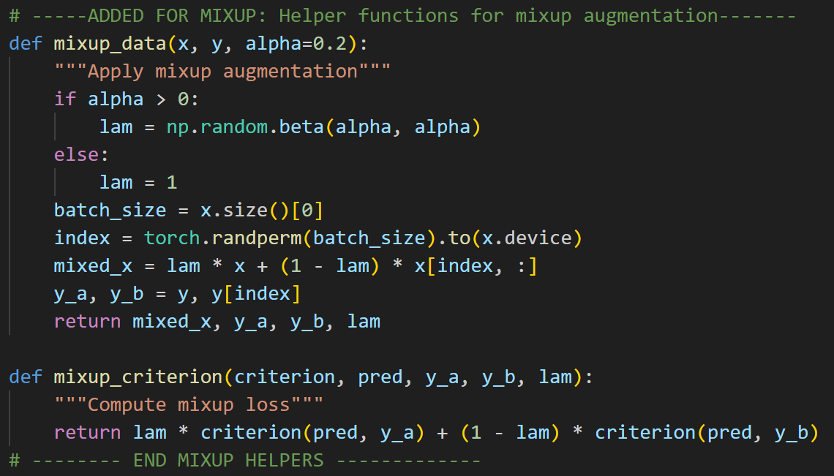
Improvements Made: Data Augmentations
Modify training loop to train model on MixUp Data and compute loss with MixUp loss
Helpers to MixUp images x and labels y using formula
Found Lamda = 0.2 for good results

Slide 14
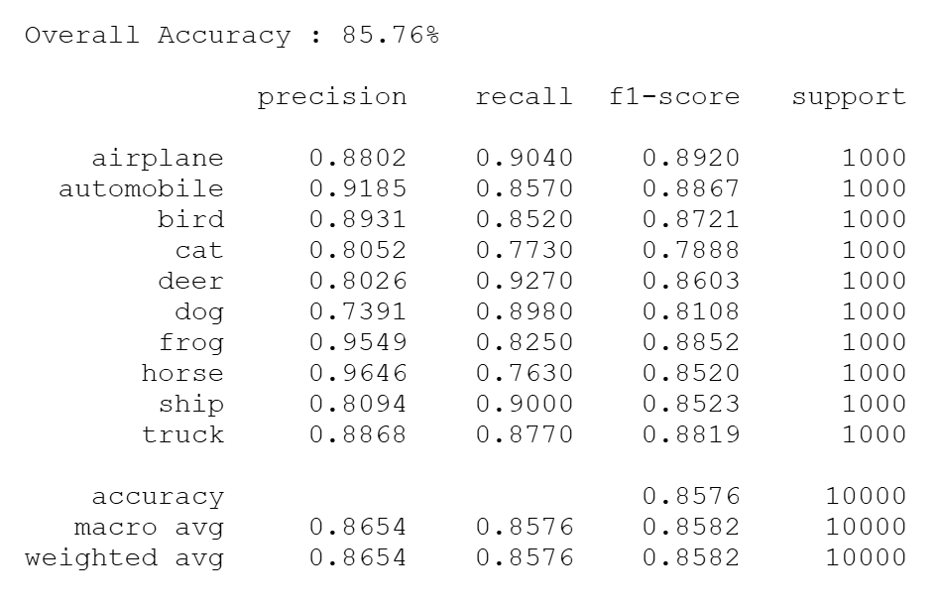
Improvements Made: Data Augmentations
No Modification:
CB-Sampling + MixUp:
Summary: Accuracy improved by 1.54%. Overall recall improved for most classes. Macro-avg increased.

Slide 15
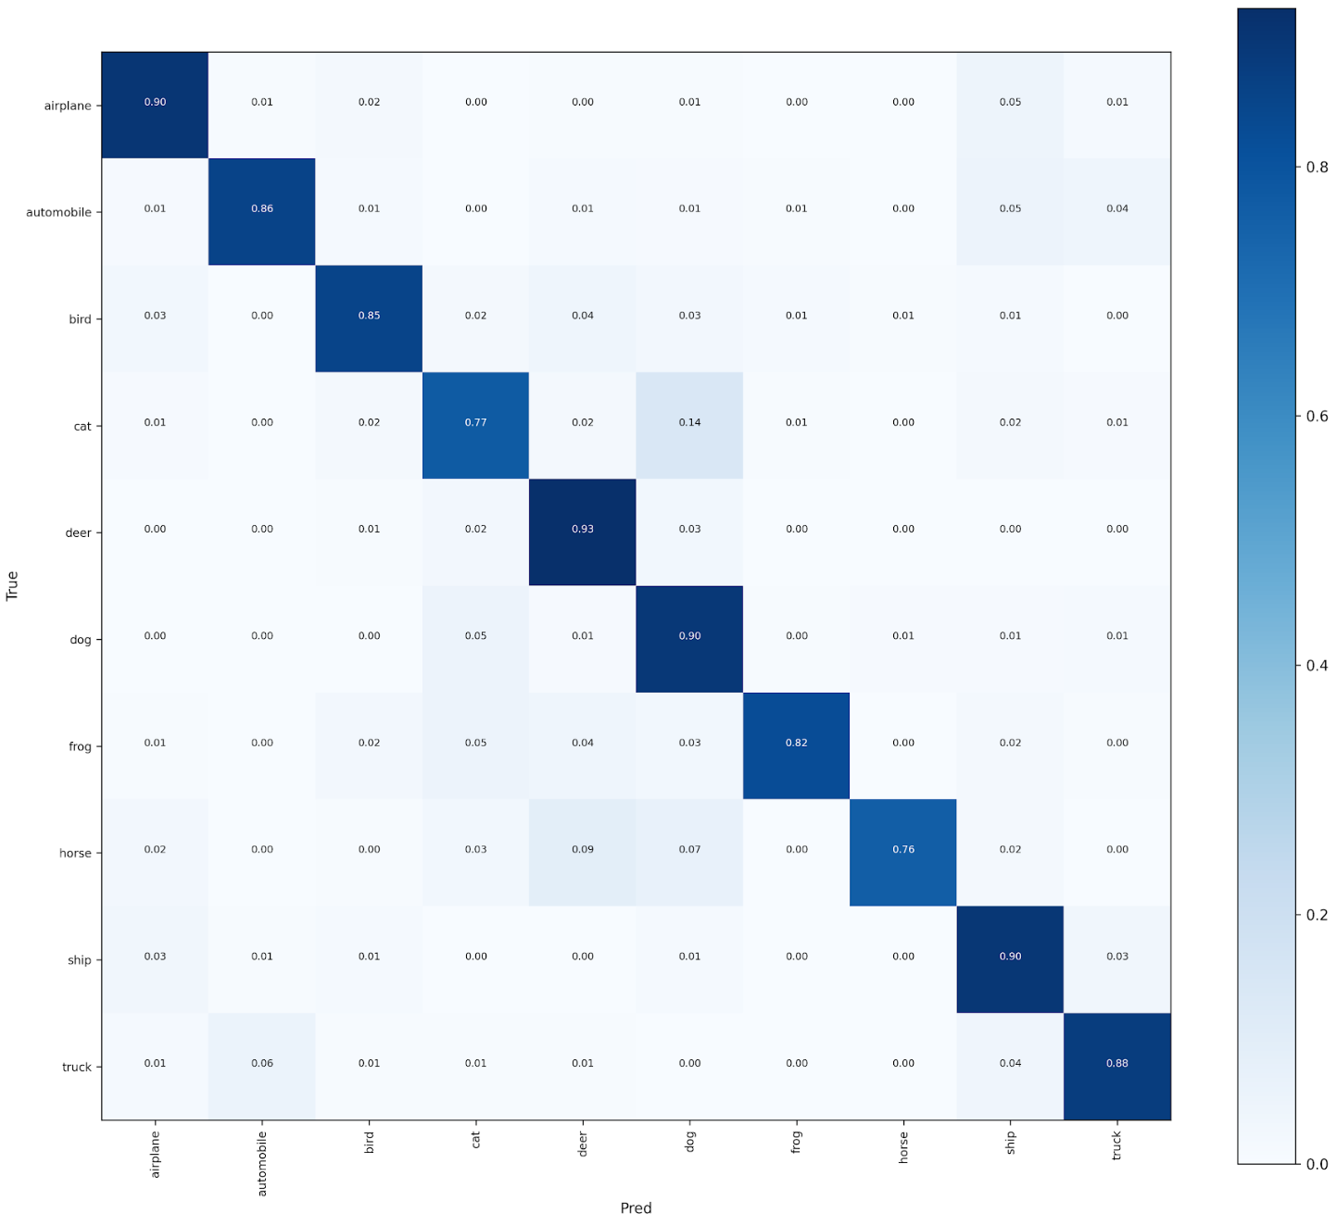
Improvements Made: Data Augmentations
No Modification:
CB-Sampling + MixUp:
Summary: Slightly less mispredictions in lower half of matrix

Slide 16
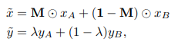
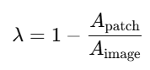
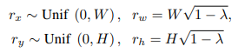
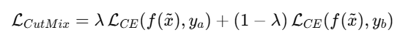
Improvements Made: Data Augmentations
What's currently happening:
Each sample corresponds to a single class
Model learns by minimizing cross-entropy between hard labels and predictions
Decision boundaries forced to be sharp
Model memorizes rather than generalizes samples
Fix: CutMix (For Tail Classes)
Cuts and paste rectangular regions between training images
Adjust labels proportionally to visible area
Model learns from multiple regions of image
Learns spatial robustness & soft labels
How it works:
Cuts a small region from one sample and pastes into another sample
Labels changed to fraction of area
Lamda computed as ratio and bounding decisions based on:
Loss becomes:
Article: S. Yun, D. Han, S. J. Oh, S. Chun, J. Choe, and Y. Yoo, “CutMix: Regularization strategy to train strong classifiers with localizable features,” Proc. IEEE/CVF Int. Conf. Comput. Vis. (ICCV), pp. 6023–6032, 2019.

Slide 17
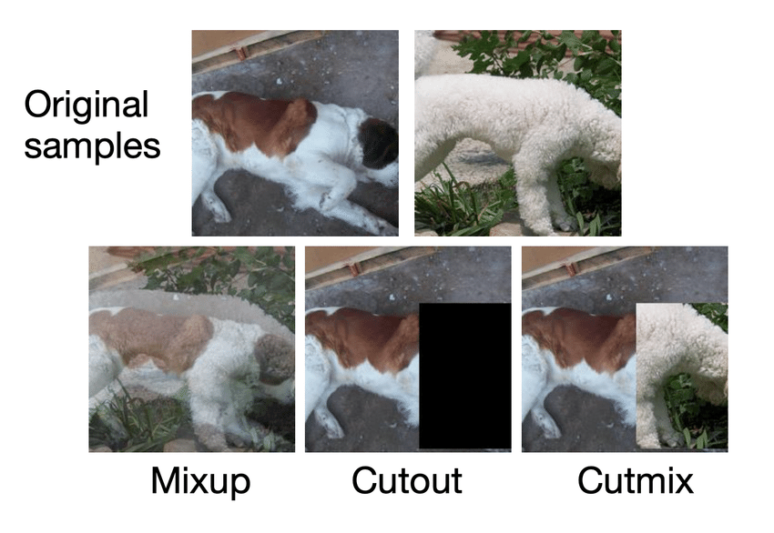
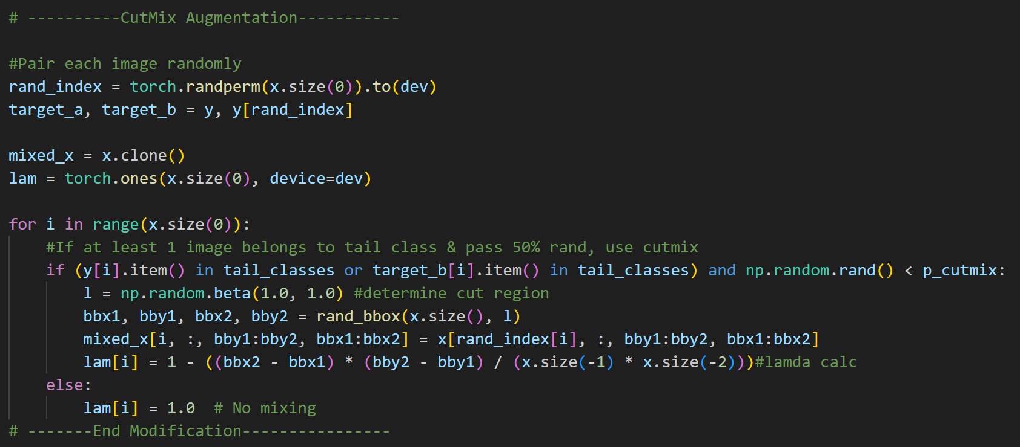
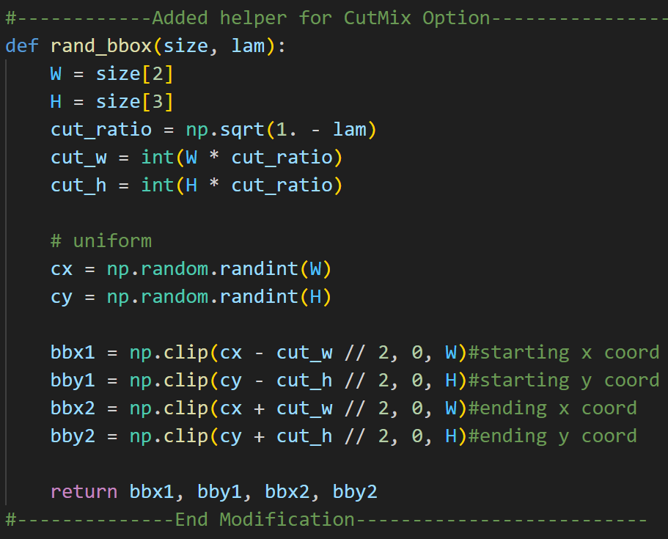
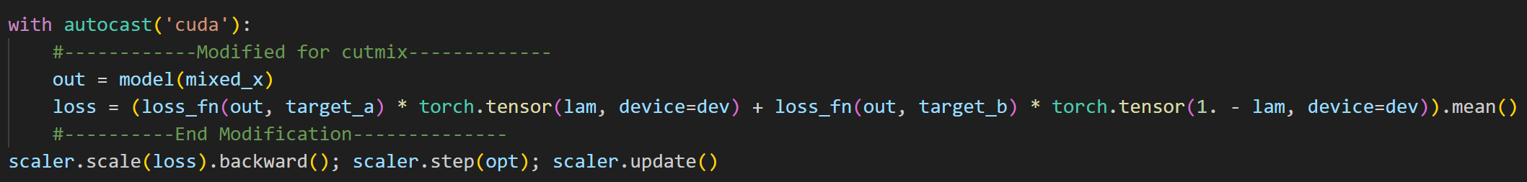
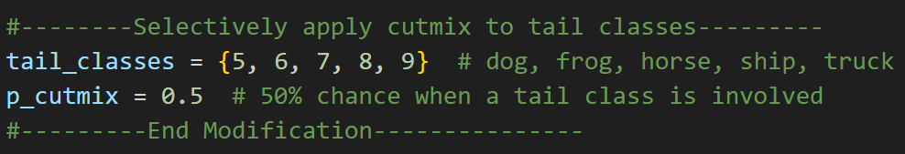
Improvements Made: Data Augmentations
Modify training loop to randomly use CutMix on tail classes at random positions
CutMix Helper to determine cut region based on lamda
Modify loss for CutMix labels
Define Tail classes and only apply CutMix with 50% prob

Slide 18
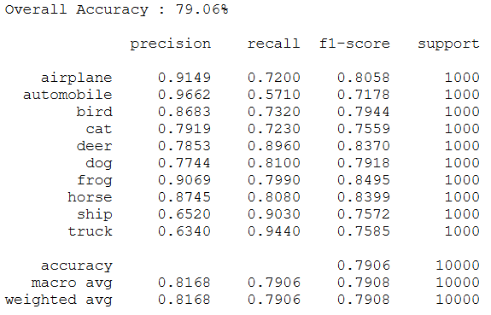
Improvements Made: Data Augmentations
No Modification:
CB-Sampling + CutMix:
Summary: Accuracy decreased by 5.16%. Overall recall decreased for most classes. Macro-avg decreased. Cut region may have been too aggressive to produce increased results. Did not commit further time testing.
*Note: Did try CutMix for all classes, but accuracy was 78.08%

Slide 19
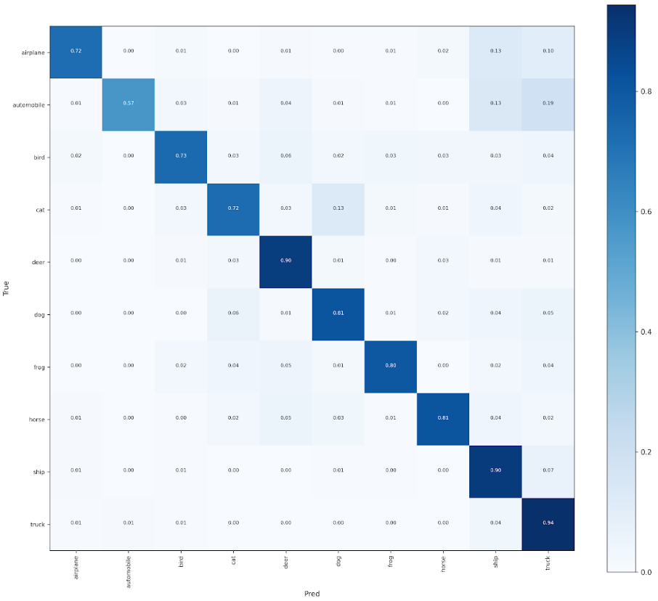
Improvements Made: Data Augmentations
No Modification:
CB-Sampling + CutMix:
Summary: Head Class diagonals decreased in accuracy while tail class dominates

Slide 20
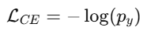
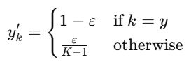
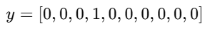
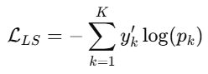
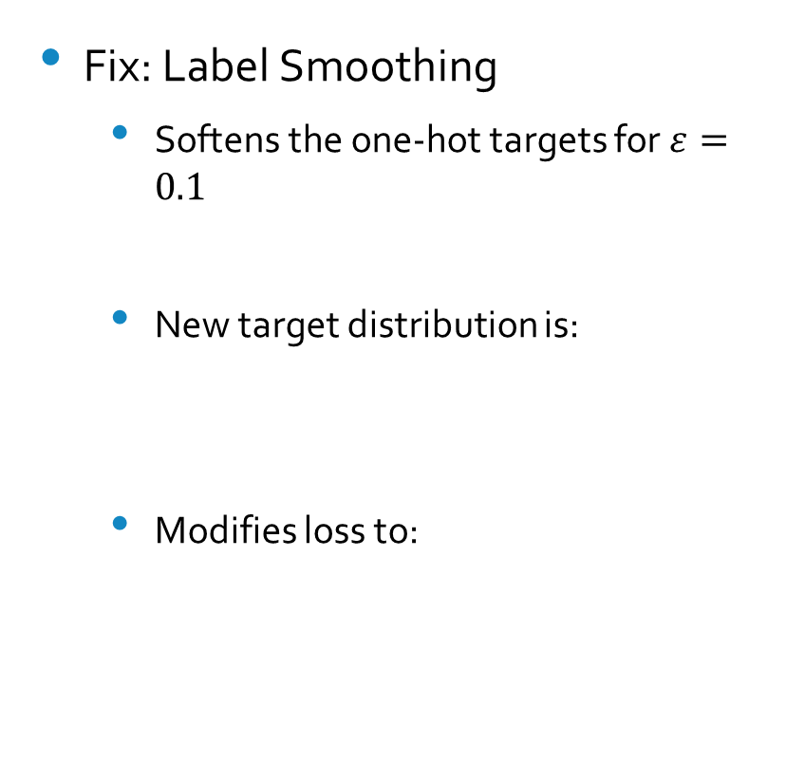
Improvements Made: Advanced Loss Functions
What's currently happening:
Loss is getting calculated by hard labels from Cross-Entropy loss
Target Label “Cat” Ex:
Models learns to be overconfident
Memorizes class-specific patterns
Fix: Label Smoothing
Softens the one-hot targets for $ε=0.1$
New target distribution is:
Modifies loss to:
Article: C. Szegedy, V. Vanhoucke, S. Ioffe, J. Shlens, and Z. Wojna, “Rethinking the Inception architecture for computer vision,” in Proc. IEEE Conf. Comput. Vis. Pattern Recognit. (CVPR), 2016, pp. 2818–2826.

Slide 21
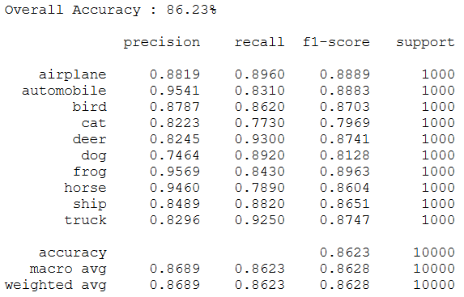
Improvements Made: Advanced Loss Functions
No Modification:
CB-Sampling + MixUp + Label Smoothing:
Summary: Accuracy increased by 2.01%. Overall recall increased for most classes. Macro-avg increased.
*Note: Changed MixUp lamda to 0.4 for slight increase

Slide 22
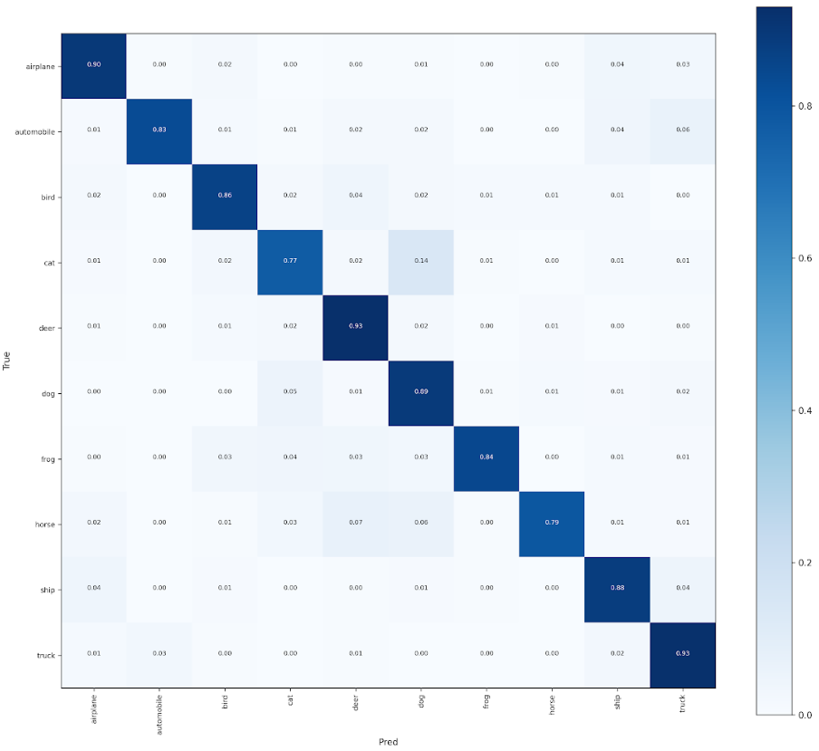
Improvements Made: Advanced Loss Functions
No Modification:
CB-Sampling + MixUp + Label Smoothing:
Summary: Tail class diagonals more accurate.

Slide 23
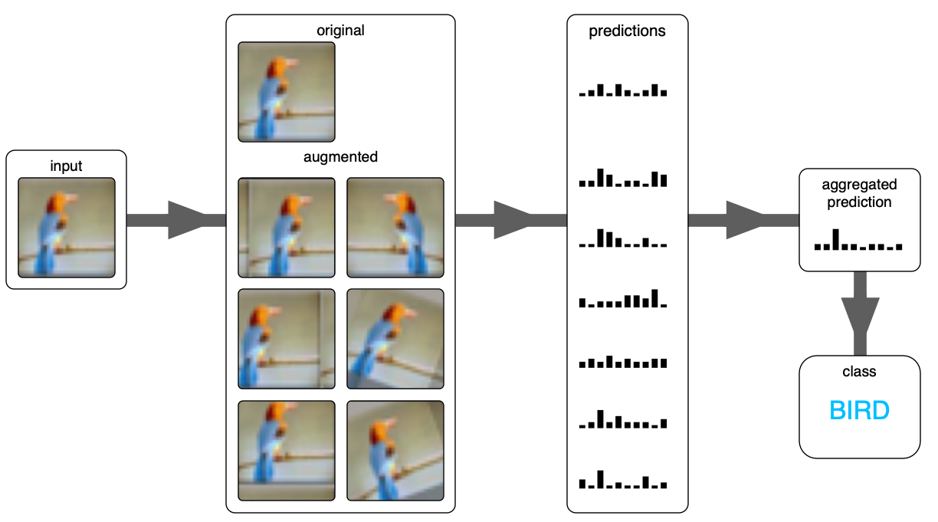
Improvements Made: Data Augmentations
What's currently happening:
Testing evaluates each image once
Might misclassify image based on one “view perspective”
Vulnerable to viewpoint bias, Scale variations & alignment shifts
Fix: Test-Time Augmentation (TTA)
Creates augmented version of test image (Flipped, rotated, scaled, etc)
Pass each version through model
Model votes over all predictions
Article: A. Krizhevsky, I. Sutskever, and G. E. Hinton, “ImageNet classification with deep convolutional neural networks,” Advances in Neural Information Processing Systems (NeurIPS), vol. 25, pp. 1097–1105, 2012.

Slide 24
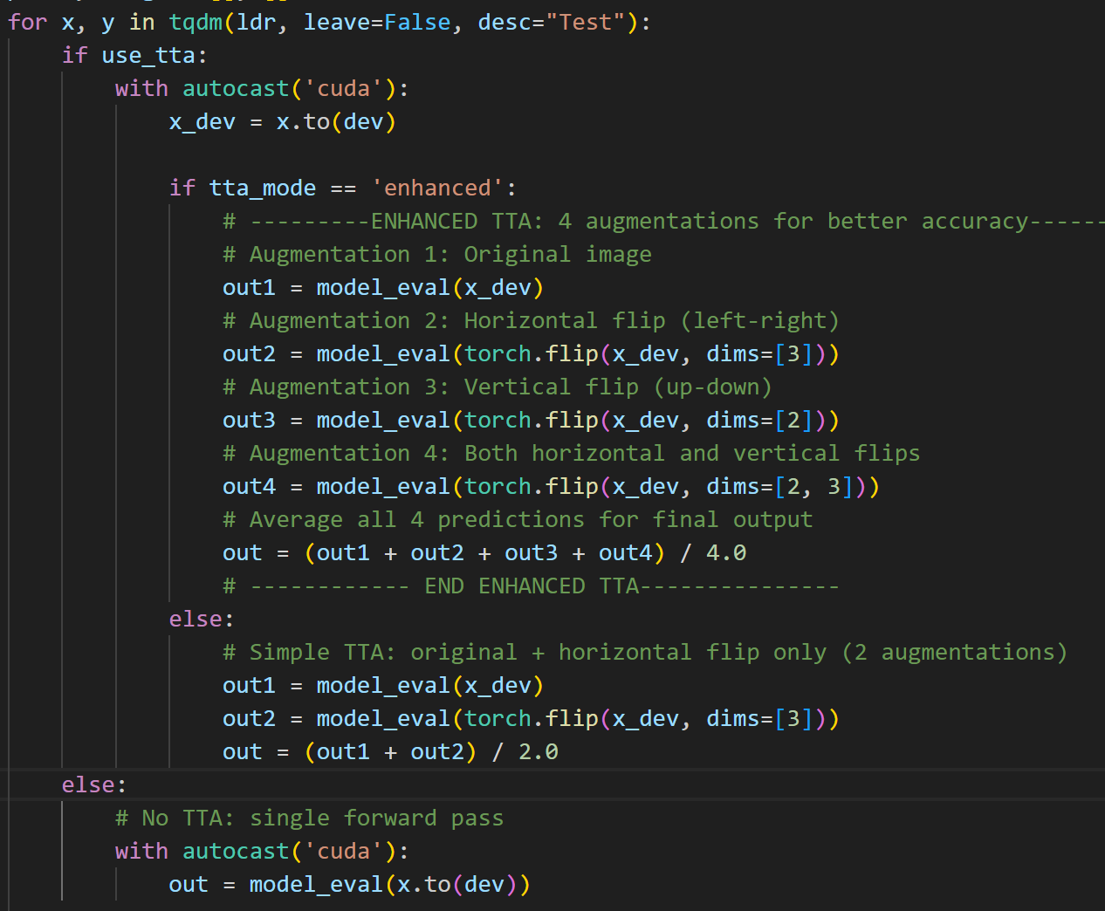
Improvements Made: Data Augmentations
Edit predict_all function to “flip” input images and average votes

Slide 25
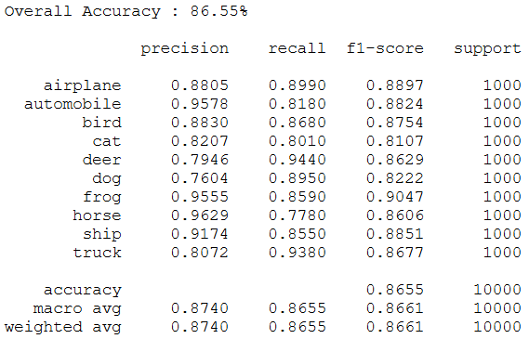
Improvements Made: Data Augmentations
No Modification:
CB-Sampling + MixUp + Label Smoothing + TTA:
Summary: Accuracy increased by 2.33%. Overall recall increased for most classes. Macro-avg increased.
*Note: Changed Label smoothing to 0.2 for slight increase
*Did not use “enhanced” TTA due to lower accuracy 85.66%

Slide 26
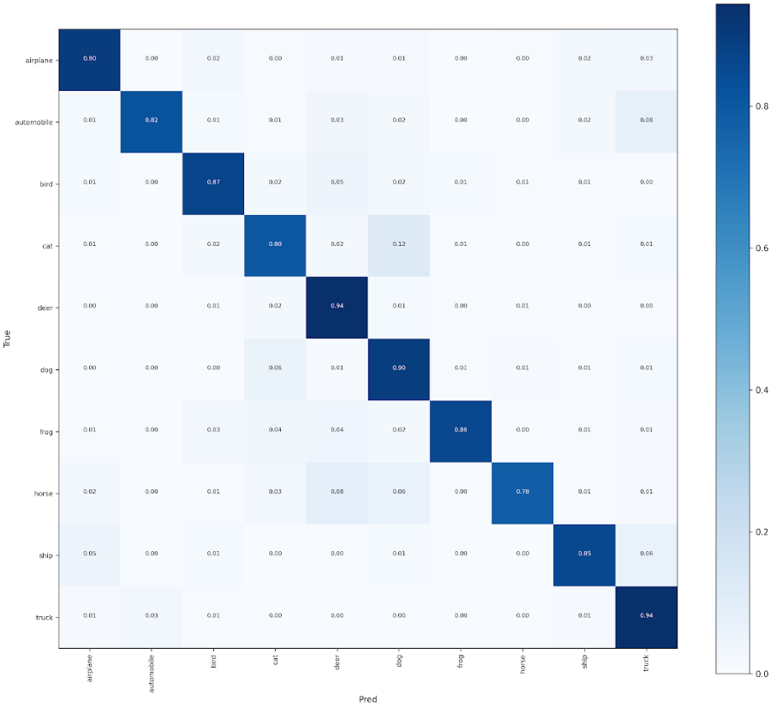
Improvements Made: Data Augmentations
No Modification:
CB-Sampling + MixUp + Label Smoothing + TTA:
Summary: Tail class diagonals more accurate.

Slide 27
Improvements Made: Decoupling Techniques
What's currently happening:
Single stage training (feature extractor & classifier trained together)
Feature extractor is bias towards head classes, classifier is skewed towards head classes
Head class produce stronger and frequent gradients
Fix: Decouple Classifier and retrain it later
(Epoch 0-20): Train whole network
(Epoch 20-30): Freeze extractor and retrain classifier
Classifier learns from stable gradients
Tail classes can improve much faster
FROZEN
Classifier
Article: B. Kang et al., “Decoupling Representation and Classifier for Long-Tailed Recognition,” Proc. Int. Conf. on Learning Representations (ICLR), 2020.

Slide 28
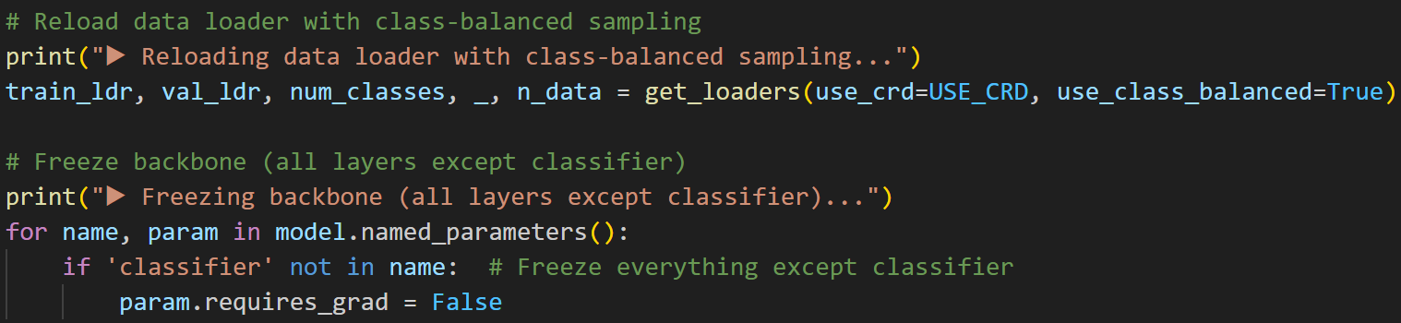
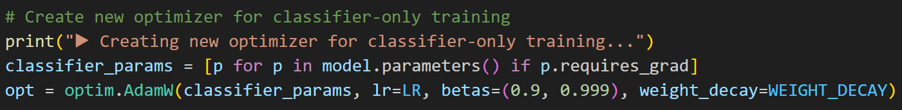
Improvements Made: Decoupling Techniques
Train model normally until epoch 20 using MixUp & label smoothening. Disable CB-Sampling.
Why disable CB-sampling for first half?
Want the backbone to see true data distribution for strong feature extraction
Using early can over-emphasive tail classes, distort data distribution, reduce feature diversity
Why disable MixUp in second stage?
MixUp encourages feature extraction, but 2nd stage is not learning features
Distort class labels
Already regularized features in stage 1
Once reach epoch 20, reload data loader with CB sampling, freeze backbone & new optimizer in training loop. Disable MixUp.
Create new optimizer & enable CB-Sampling. Reset Learning Rate, keep default hyperparams.

Slide 29
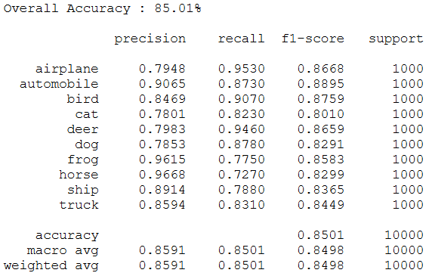
Improvements Made: Decoupling Techniques
No Modification:
CB-Sampling + MixUp + Label Smoothing + TTA + Decoupling:
Summary: Accuracy increased by 0.79%. Overall recall increased slightly. Macro-avg slightly increased.

Slide 30
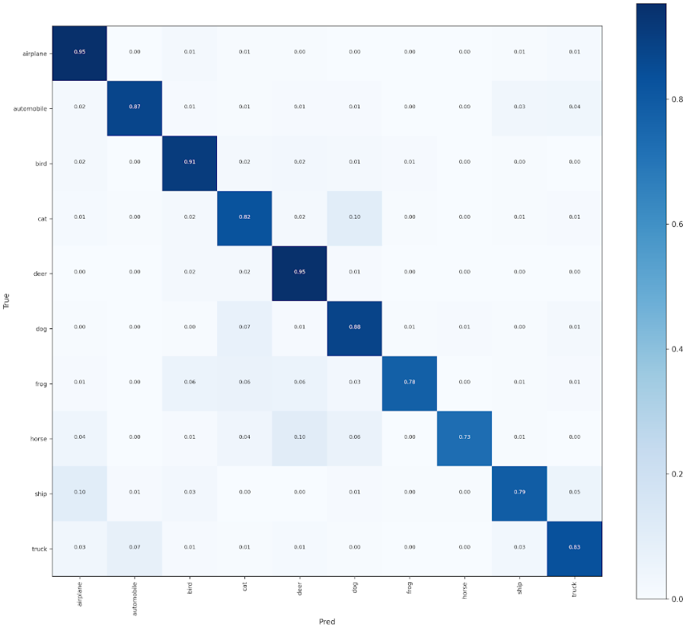
Improvements Made: Decoupling Techniques
CB-Sampling + MixUp + Label Smoothing + TTA + Decoupling:
No Modification:
Summary: Slight decrease in misclassifications in lower half

Slide 31
Overall Best Model Adjustments:
CB-Sampling + MixUp + Label Smoothing + TTA:
Achieves 86.55% Accuracy (+2.33%)
0.8740 Macro-Avg Precision (+0.0212)
0.8661 Macro-Avg F1-score (+0.0243)
EfficientNet
Label Smoothing
MixUp
TTA
CB-Sampling
Resampling
Data Augmentation
Advance Loss Function
Data Augmentation

Slide 32
Conclusion:
Attempted These Modification:
ReSampling:
Class Balanced Sampling
Data Augmentation:
MixUp
CutMix
TTA
Advance Loss Function:
Label Smoothing
Decoupling:
Train whole model in stage 1
Train Classifier only in stage 2
Final Thoughts: Most methods did improve the model by themselves, while some methods may not be compatible with each other. Further tweaking of parameters can improve model performance, but not efficient use of time.

